Slide 1
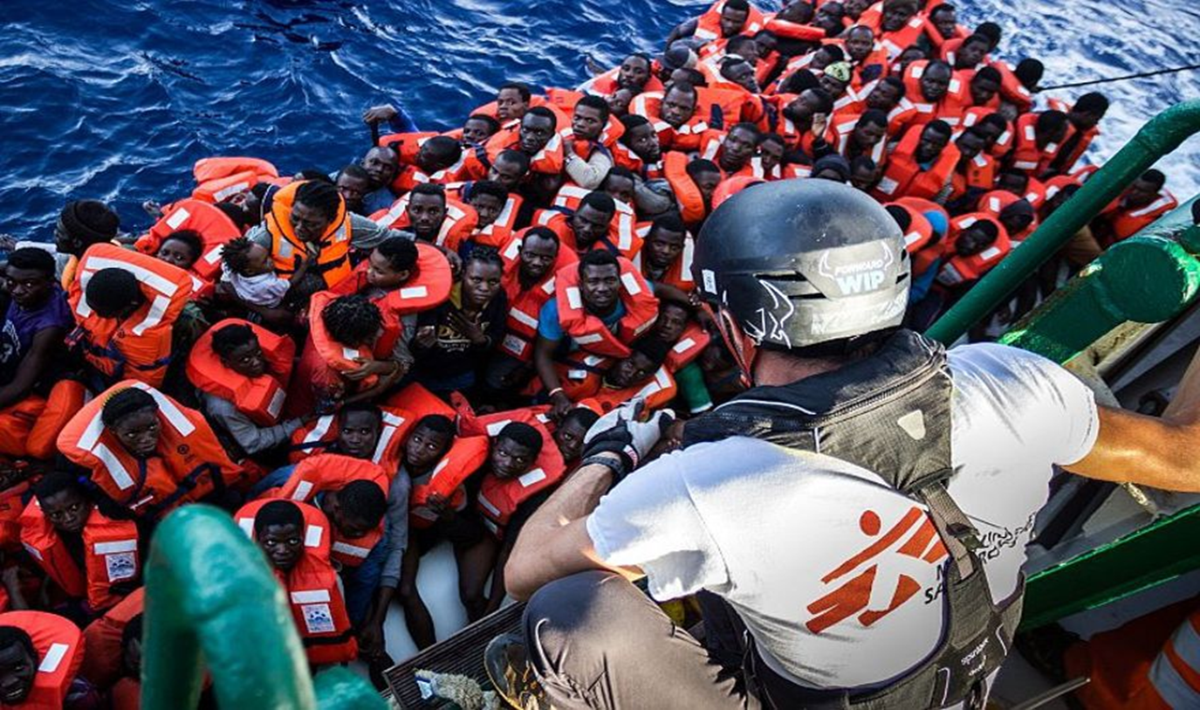

Human Rights, HIV and the SDGs: Migrants in the Centre
Marc Biot, MD, MSc
Médecins Sans Frontières

Slide 2
“Criminalization” of migration
  Increasing health & humanitarian needs
  Forces people to live in irregularity
  Impacts free movement of persons also in other regions (SADC- ECOWAS- …)

Slide 3
Increased Health Risks due to mobility
  Travel & detention conditions
  Abuse before/during travel and in Europe
  Limited access to health care: interruptions / delayed start
  Stigma impacting health seeking behaviour; language barriers
  Lack of harmonized treatment regimes & protocols
  Increased vulnerable to high-risk sexual behaviour
  Forced returns without attention to health needs ➔ interrupted chronic treatments
Notes:
SHOULD READ : UNWANTED Health Risks
Risks during travel:
Conditions of travel conditions
Victims of trafficking
Robberies and violence by officials, host population and travelling companions.
Abuse: murder, rape, sexual violence, ../..
Impact of detention on health:
Insufficient vulnerability screening leading to vulnerable people being detained
Overcrowded and unsanitary conditions. ➔ HIV & TB (800 increase in over-crowded Malawi prison)
Impact of detention on mental health: Original traumatic events; Trauma of the journey
Limited access to healthcare

Slide 4
Barriers to accessing health care
The European Convention on Human Rights (ECHR) (Art 3): “to restrain from expulsion the ill migrants if this act would amount to an inhuman and degrading treatment”
  Major restrictions
  HIV-related restrictions on entry, residence or stay enacted in various countries
  Confusion between availability & effective accessibility and adequate stocks in country of origin
  Linking health status to migration enforcement increases distrust of the health system
Notes:
Authorities have a tendency to mix up the availability, even if partial, of the drugs with the effective accessibility of the treatments.
Accessibility of treatments, geographically and financially, means also the existence of an appropriate follow up, of medical tools, and of an ad
equate stock
The lack of a reliable, independent source of information on the countries of origin creates an additional problem.
In 2007 an internet website (www.ithaca-eu.org ) with the information collected was launched. MSF information and expertise could become an important element in favour of the regularization of foreign persons illegally present in Belgian territory or in other European countries:
63 different countries among : Central Africa and Eastern Europe.
HIV/AIDS, diabetes, serious hearth diseases or psychiatric cases most common.
In June 2007 a new legal framework on medical protection was issued which allowed for an increase of regularization for medical reasons. In 2008 the project was closed and handed over to ecoi.net (http://www.ecoi.net/ ), a specialist in information of countries of origin but more in a political point of view rather than health information.

Slide 5
Samos & Lesbos : 2017
70- 80% of MH assessments : anxiety disorder “+”
  <15% of severe MH patients identified as vulnerable
  <30% of victims of torture had been identified as vulnerable
19% reported experiencing sexual violence (11/59)
  PEP only provided after a legal enquiry; not seen as a medical emergency; mainly for staff
Access to an appropriate medicine for those who suffered from a chronic disease on sites varied from 38.1% to 83.5%
Sources: Epicentre, LSHTM & MSF:
Migrants’ journey, vulnerabilities, access to information and endured violence during the journey and in refugee camps in Ioannina, Attica, Athens and Samos, Greece April 2017
Notes:
This violence was experienced in people’s country of origin, in transit and in Greece.
In total, 1293 individuals were included;

Slide 6
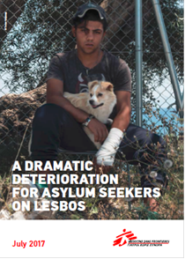
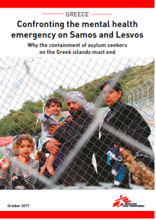
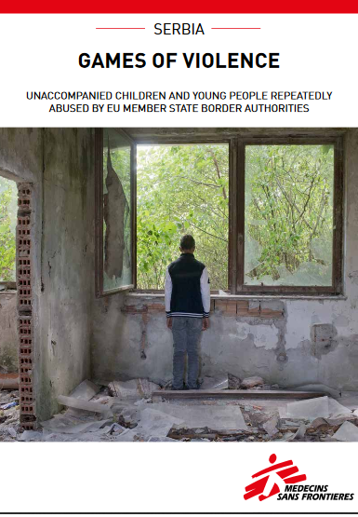
https://www.msf.org/sites/msf.org/files/serbia-games-of-violence-3.10.17.pdf
https://www.msf.org/sites/msf.org/files/msf_lesbos_vulnerability_report1.pdf
https://www.msf.org/sites/msf.org/files/2018-06/confronting-the-mental-health-emergency-on-samos-and-lesvos.pdf

Slide 7
Conclusion
Europe is blind on the health needs of its migrants: security concerns prevail!
Restrictive policies increase health risks: European migration policies: source of new HIV infections
Need for independent data base on availability & accessibility of treatment managed by Civil Society

